Slide 1
Infosys : CPP with Assembler Support
CAST - GAIC Tooling Team

Slide 2
Deck Version History
Versions | Content/update
Draft | Proposed plan
1.0 | Updated the proposed schedule date. Shared on 9th Aug
1.1 | Updated to include the : Talking points of 12th sept meeting and next steps Additional two patterns for C++ to ASM identified and added in the backlog Included the slide for “parameterized function query” discussed and addressed by Infosys on 10th sept
1.2 | Updated with four Enlighten call flows from C++ to Assembler (iteration 1)
1.3 | Updated with ASM to C++ 2 pattern
1.4 | Updated with two enlighten flows for ASM to C++ Updated with Instruction for extension installation and pattern configuration

Slide 3
Today’s Talking Points (12/sept/2019)
For Iteration 1 – We would like to stick with the same scope and schedule as agreed on 9th Aug : Karthik to confirm
Additional Patterns Identified: We propose, these new patterns be added to backlog and taken in future iterations.
CAST identified Two more patterns for C++ to assembler during the requirement document which CAST can consider for development in future iteration.
Manjula suggested there could be many other patterns for C++ to Assembler, but not known as of now.
As discussed in meeting(sept – 10th ), Manjula to share the code snippet call flow. Post our study we will advice on the feasibility and for future iteration
Incase we get sample code by 13th sept., CAST can review sample code and advice what is feasible in iteration 1

Slide 4
Next Steps
Discussion on possible Development Methodology, we can stabilize at, post initial iterations.
Discussed possible methodology we can adopt for future iterations
CAST to propose draft methodology on 20th Sept.
SOW for Future Iterations:
CAST proposes future iterations be taken on SOW basis (as service days are meant for SME, FO, BO etc utilizations)

Slide 5
Assembler Extension Development
Scope
C++ to Assembler
Various pattern
Call flow
Sample source
Estimation
Q&A
Indicative future scenarios are
Assembler to C++ (Scenarios and Estimates to be provided during Iteration 1)
Assembler to Assembler
NOTE: Due to Lack of expertise in Assembler, CAST is not able to estimate/discover the full scope (100% of scenarios, object types) and hence proposing an iterative approach, in which, CAST will discover scope iteratively and develop in iteration. This impacts our ability to provide a full scope, timeline and effort. We request, Infosys, to provide us, with the scenarios, scope, which will enable CAST to provide estimates, subject to technical feasibility.
Notes:
DLM Standard rules are now blessed with R&D
Ensure that extensions are applied based on Light tech survey & DMT framework report

Slide 6
Patterns and Priorities - Backlog
Backlog of requirements (Patterns) and Priorities.
NOTE: This backlog is an initial version and this can be jointly updated, curated by both CAST and Infosys.
Notes:
DLM Standard rules are now blessed with R&D
Ensure that extensions are applied based on Light tech survey & DMT framework report

Slide 7
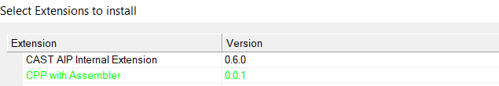
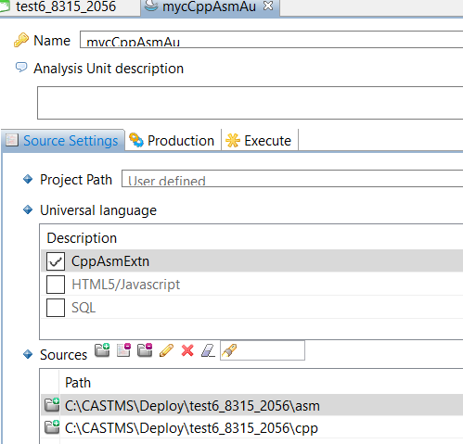
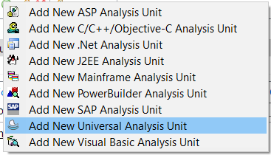
Instruction for extension Installation
Step# 3.
Select “CppAsmExtn” from Universal Language list
Step# 1. Copy the extension in CAST extension folder and then
using ServMan, select below mentioned extension
Step# 2.
In CMS, Add the Analysis Unit for the package selected
Select “asm” & “C++” source path as above

Slide 8
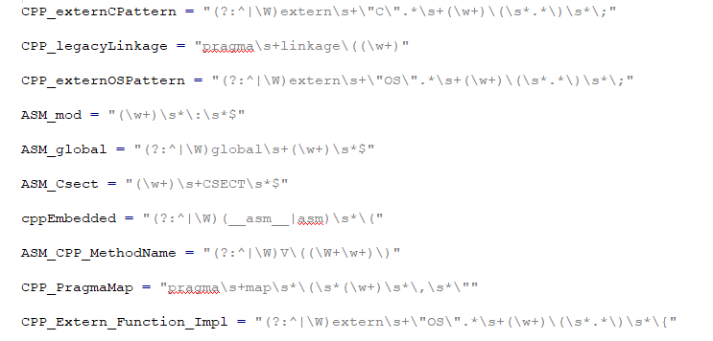
Instruction for Pattern configuration
Pattern configuration file: <extension>\utils\CppAsmPatterns.py
For any new patterns, update below with regex-OR condition

Slide 9
Pattern #1 – Priority 1 C++ to ASM call flow
Sample source
Call flow
.cpp
#include <iostream>
using std::cout;
extern "C" int _add(int a, int B);
int main() {
int ret = _add(10, 20);
cout << "add returned:" << ret;
return 0;
}
C++
ASM File
Assembler code/module
.asm
global add
add:
mov eax, [esp+4]
mov edx, [esp+8]
add eax, edx
ret
Notes:
DLM Standard rules are now blessed with R&D
Ensure that extensions are applied based on Light tech survey & DMT framework report

Slide 10
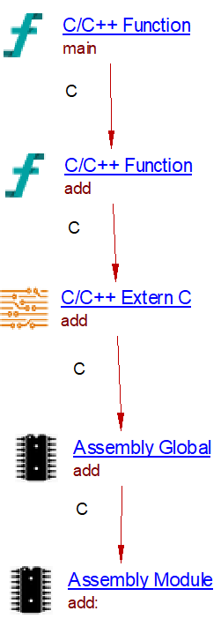
Pattern #1 – Priority 1 Enlighten C++ to ASM call flow
Enlighten call flow
Sample source
.cpp
#include <iostream>
using std::cout;
extern "C" int _add(int a, int B);
int main() {
int ret = _add(10, 20);
cout << "add returned:" << ret;
return 0;
}
.asm
global add
add:
mov eax, [esp+4]
mov edx, [esp+8]
add eax, edx
ret
Notes:
DLM Standard rules are now blessed with R&D
Ensure that extensions are applied based on Light tech survey & DMT framework report

Slide 11
Pattern #2 C++ to ASM call
Call flow
Sample source
C++
.cpp
#include <iostream>
using std::cout;
extern “OS" int PRINTTHIS(void);
int main() {
PRINTTHIS();
return 0;
}
ASM File
Assembler code/module
.asm
PRINTTHIS CSECT
ADDR_BLK DC A(FMTSTR)
DC A(X'80000000'+INTVAL) high bit on the last address
FMTSTR DC C 'Sample formatting string'
DC C 'includes an int -- %d --'
DC AL1(NEWLINE,NEWLINE)
DC C 'and two newline characters'
DC AL1(NULL)
INTVAL DC F '222' The integer value displayed
NULL EQU X '00' C NULL character
NEWLINE EQU X '15' C \n character
END

Slide 12
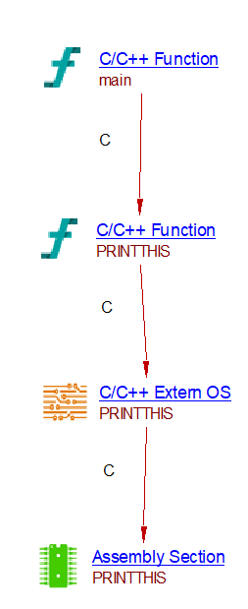
Pattern #2 Enlighten C++ to ASM call
Sample source
Enlighten call flow
.cpp
#include <iostream>
using std::cout;
extern “OS" int PRINTTHIS(void);
int main() {
PRINTTHIS();
return 0;
}
.asm
PRINTTHIS CSECT
ADDR_BLK DC A(FMTSTR)
DC A(X'80000000'+INTVAL) high bit on the last address
FMTSTR DC C 'Sample formatting string'
DC C 'includes an int -- %d --'
DC AL1(NEWLINE,NEWLINE)
DC C 'and two newline characters'
DC AL1(NULL)
INTVAL DC F '222' The integer value displayed
NULL EQU X '00' C NULL character
NEWLINE EQU X '15' C \n character
END

Slide 13
Pattern #3 Legacy C++ to ASM
Call flow
Sample source
.cpp
#include <iostream>
using std::cout;
#pragma linkage(PRINTTHIS, OS)
int main() {
PRINTTHIS();
return 0;
}
C++
ASM File
Assembler code/module
.asm
PRINTTHIS CSECT
ADDR_BLK DC A(FMTSTR)
DC A(X'80000000'+INTVAL) high bit on the last address
NULL EQU X '00' C NULL character
NEWLINE EQU X '15' C \n character
END

Slide 14
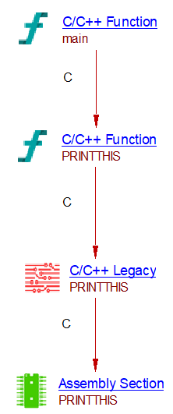
Pattern #3 Enlighten Legacy C++ to ASM
Sample source
Enlighten call flow
.cpp
#include <iostream>
using std::cout;
#pragma linkage(PRINTTHIS, OS)
int main() {
PRINTTHIS();
return 0;
}
.asm
PRINTTHIS CSECT
ADDR_BLK DC A(FMTSTR)
DC A(X'80000000'+INTVAL) high bit on the last address
NULL EQU X '00' C NULL character
NEWLINE EQU X '15' C \n character
END

Slide 15
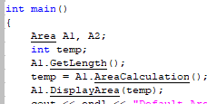
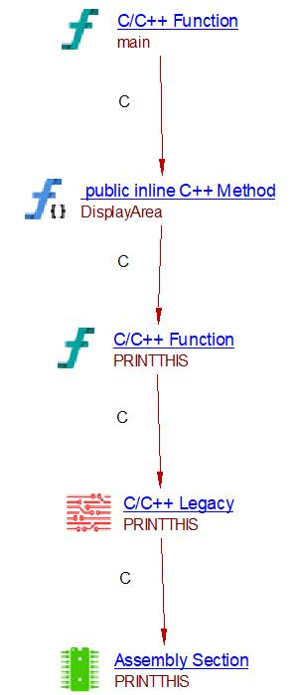

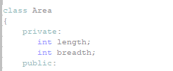

Pattern #4 Enlighten C++ Object instantiation to ASM
Sample source
Enlighten call flow
.asm
PRINTTHIS CSECT
ADDR_BLK DC A(FMTSTR)
DC A(X'80000000'+INTVAL) high bit on the last address
NULL EQU X '00' C NULL character
NEWLINE EQU X '15' C \n character
END

Slide 16
Pattern #5 Assembler to C++ call
Call flow
Sample source
.asm
PRINTTHIS CSECT
EDCPRLG
LA 1,ADDR_BLK parameter address block in r1
L 15,=V(@PRINTF4) address of routine
BALR 14,15
EDCEPIL
ADDR_BLK DC A(FMTSTR) parameter address block with..
DC A(X'80000000'+INTVAL) ..high bit on the last address
FMTSTR DC C'Sample formatting string'
DC C' which includes an int -- %d --'
DC AL1(NEWLINE,NEWLINE)
DC C'and two newline characters'
DC AL1(NULL)
*
INTVAL DC F'222' The integer value displayed
*
NULL EQU X'00' C NULL character
NEWLINE EQU X'15' C \n character
END
ASM File
Assembler code
C++
.cpp
#include <iostream>
using std::cout;
#include <stdio.h>
#pragma map(_printf4,"@PRINTF4")
extern "OS" int _printf4(char *str,int i) {
return printf(str,i);
}

Slide 17
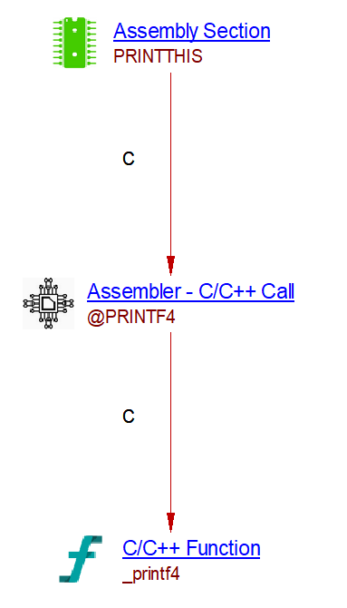
Pattern #5 Enlighten Assembler to C++ call
Call flow
Sample source
.asm
PRINTTHIS CSECT
EDCPRLG
LA 1,ADDR_BLK parameter address block in r1
L 15,=V(@PRINTF4) address of routine
BALR 14,15
EDCEPIL
ADDR_BLK DC A(FMTSTR) parameter address block with..
DC A(X'80000000'+INTVAL) ..high bit on the last address
FMTSTR DC C'Sample formatting string'
DC C' which includes an int -- %d --'
DC AL1(NEWLINE,NEWLINE)
DC C'and two newline characters'
DC AL1(NULL)
*
INTVAL DC F'222' The integer value displayed
*
NULL EQU X'00' C NULL character
NEWLINE EQU X'15' C \n character
END
.cpp
#include <iostream>
using std::cout;
#include <stdio.h>
#pragma map(_printf4,"@PRINTF4")
extern "OS" int _printf4(char *str,int i) {
return printf(str,i);
}

Slide 18
Pattern #6 Assembler to C++ - Legacy call
Sample source
Call flow
.asm
PRINTTHIS CSECT
EDCPRLG
LA 1,ADDR_BLK parameter address block in r1
L 15,=V(@PRINTF4) address of routine
BALR 14,15
EDCEPIL
ADDR_BLK DC A(FMTSTR) parameter address block with..
DC A(X'80000000'+INTVAL) ..high bit on the last address
FMTSTR DC C'Sample formatting string'
DC C' which includes an int -- %d --'
DC AL1(NEWLINE,NEWLINE)
DC C'and two newline characters'
DC AL1(NULL)
*
INTVAL DC F'222' The integer value displayed
*
NULL EQU X'00' C NULL character
NEWLINE EQU X'15' C \n character
END
ASM File
Assembler code
C++
.cpp
#pragma linkage(_printDocument,OS)
#include <stdio.h>
#pragma map(_printDocument,“@PRINTF4”)
int _printDocument(char *str,int i) {
return printf(str,i);
}

Slide 19
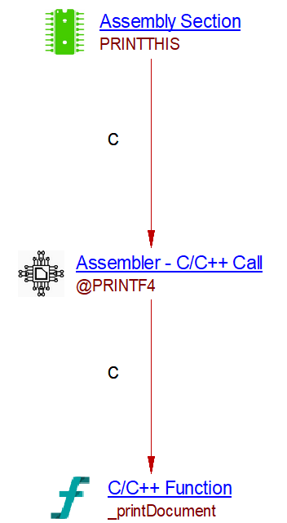
Pattern #6 Enlighten Assembler to C++ - Legacy call
Call flow
Sample source
.asm
PRINTTHIS CSECT
EDCPRLG
LA 1,ADDR_BLK parameter address block in r1
L 15,=V(@PRINTF4) address of routine
BALR 14,15
EDCEPIL
ADDR_BLK DC A(FMTSTR) parameter address block with..
DC A(X'80000000'+INTVAL) ..high bit on the last address
FMTSTR DC C'Sample formatting string'
DC C' which includes an int -- %d --'
DC AL1(NEWLINE,NEWLINE)
DC C'and two newline characters'
DC AL1(NULL)
*
INTVAL DC F'222' The integer value displayed
*
NULL EQU X'00' C NULL character
NEWLINE EQU X'15' C \n character
END
.cpp
#pragma linkage(_printDocument,OS)
#include <stdio.h>
#pragma map(_printDocument,“@PRINTF4”)
int _printDocument(char *str,int i) {
return printf(str,i);
}

Slide 20
How assembler is receiving parameters from C++ overloaded methods?
If function without any parameter, then we will be able to create link from C++ to appropriate assembler side code based on the naming convention.
- As per discussion with Manjula on Sep-10th CAST can link based on naming convention from CPP to ASM for any type of parameterized method calls. So below question is addressed by following this approach
If function with any parameters…. Like (pass by value, pass by reference) sample parameter mentioned below
Parameter types: Basic datatype like: int, float, bool, double, etc.,
Parameter types: Struct, Union, Pointer, Array
Parameter types: Class objects/instance of Class, etc.,
In this case how assembler is receiving parameters from C++ function
is it anything from below [OR] something else?
&VAR2 SETC ’1,2’
MAC1 KEY=(&VAR2)
SETC
&NAME MOVE &TO,&FROM
&KEY(1) DC &KEY(2) ’&KEY(3)’

Slide 21
Pattern #2 – Priority 1 ASM to C++ call flow
During Iteration 1, CAST will provide the in-scope scenarios and effort estimates required to develop the linkage – ASM to C++
Notes:
DLM Standard rules are now blessed with R&D
Ensure that extensions are applied based on Light tech survey & DMT framework report

Slide 22
Iteration 1 – Effort , Indicative Schedule
Initial extension: 20 days
Requirement documentation – (3 days)
One-time activity - Extension creation : – (5days)
Scenario (for slide #3, #4, #5)
Artifact creation – (3 days)
Linkages from C++ to ASM – (3 days)
R&D and Estimate for Assembler to C++ - (3 days)
UAT – (3 days)
Proposed Schedule – Start Date is based on the availability of extension delivery team
Requirement/Task | Owner | 3/Sep | 4/Sep | 5/Sep | 6/Sep | 7/Sep | 8/Sep | 9/Sep | 10/Sep | 11/Sep | 12/Sep | 13/Sep | 14/Sep | 15/Sep | 16/Sep | 17/Sep | 18/Sep | 19/Sep | 20/Sep | 21/Sep | 22/Sep | 23/Sep | 24/Sep | 25/Sep | 26/Sep | 27/Sep
Requirement Documentation
Preparation | CAST
Review and Sign off | Infosys
One time Activity - Extension setup, skeleton code | CAST
C++ to ASM Linkage Development and Testing
Artefact Creation | CAST
Linkages from C++ to ASM | CAST
Demo and UAT, Signoff | Infosys & CAST
R&D and Estimation for ASM to C++ Linkage | CAST
Extension delivered with C++
to ASM linkage as in slide 4

Slide 23
Iteration 1 –Dependencies & Risks
Dependency
CAST requires Infosys to provide approval on Effort Estimate and billing of Effort to Infosys. NOTE: CAST suggests utilizing the available service days, for billing this activity.
CAST request Infosys to provide sample source code/pseudo code for testing C++ to ASM linkage and ASM to C++ linkage.
Sign-offs Required from Infosys:
CAST requires sign-off on Requirement Document, as per schedule
CAST requires UAT sign-off on final deliverable.
Risks

Slide 24
Future Scenarios

Slide 25
Patterns and Priorities - Backlog
Backlog of requirements (Patterns) and Priorities.
NOTE: This backlog is an initial version and this can be jointly updated, curated by both CSAT and Infosys.
Notes:
DLM Standard rules are now blessed with R&D
Ensure that extensions are applied based on Light tech survey & DMT framework report

Slide 26
Pattern #7 – Priority 2 Call from C++ to Embedded Assembler source
Sample source
Embedded Assembler
Call flow
int main( ) {
__asm__( "movl $10, %eax;"
"movl $20, %ebx;"
"addl %ebx, %eax;");
------------------OR------------------
asm( "movl $10, %eax;"
"movl $20, %ebx;"
"addl %ebx, %eax;");
return 0 ;
}
C++
Embedded assembler code/module
Notes:
DLM Standard rules are now blessed with R&D
Ensure that extensions are applied based on Light tech survey & DMT framework report

Slide 27
Pattern #8 Priority - 2 Call from C++ to Parameterized Embedded Assembler source
Sample source
Embedded with PARAMETER in C++
Call flow
int main( ) {
int joe=1234, fred;
__asm__( "mov %1,%%eax\n"
"add $2,%%eax\n"
"mov %%eax,%0\n"
:"=r" (fred)
:"r" (joe)
:"%eax");
---------------OR ---------------
asm"mov %1,%%eax\n"
"add $2,%%eax\n"
"mov %%eax,%0\n"
:"=r" (fred)
:"r" (joe)
:"%eax");
return fred;
}
C++
PARAMETERIZED Embedded assembler code/module
Notes:
DLM Standard rules are now blessed with R&D
Ensure that extensions are applied based on Light tech survey & DMT framework report

Slide 28
Q&A

